Slide 1

WIPRO NGA Program – SDET – Batch No:1
Capstone Project Presentation – 9th Sept 2024
Project Title –Gillette Website
Presented by –Bellamkonda Dhrama Siva Sai Dinesh
www.rpsconsulting.in

Slide 2

Introduction
Title: Automated Testing of Gillette
Project Overview:
This project aims to automate the testing of various functionalities of the Gillette.com website using Selenium BDD with Cucumber , manual testing techniques, API testing, The goal is to ensure the reliability, functionality, and user experience of the e-commerce platform.
2024 - RPS Consulting all rights reserved

Slide 3
objective
Objectives of Automation Testing:
To automate and enhance the testing process of Gillette.com to ensure a smooth user experience.
Key Objectives:
It reduces manual testing efforts and Increases test coverage and accuracy and Integrate testing with CI/CD pipelines.
Ensure Quality and Reliability of Software Products and Automate Testing to Improve Efficiency , Identify and Resolve Issues Early in Development.
Purpose:
The purpose of automation testing for Gillette.com, or any large-scale e-commerce platform, is multifaceted and crucial for maintaining high standards of quality, performance, and user experience.
Key purpose of Automation Testing:
Increase Efficiency
Enhance Test coverage
2024 - RPS Consulting all rights reserved

Slide 4
About the Application
Application overview:
Application : Gillette.com
Tools and TECHNOLOGIES:
UI Testing: Selenium WebDriver
Manual Testing: Jira
API Testing: Rest Assured
BDD: Cucumber
Key Features & Functionality:
Home page , Search functionality , Product functionality , , Filter , and Order placement.
2024 - RPS Consulting all rights reserved

Slide 5
Task Completed:
Selenium BDD with Cucumber:
Implemennted the automated UI tests with Selenium Web driver.
Developed BDD Scenarios with Cucumber.
API Testing:
Tested API endpoints using Postman and RestAssured.
Conducted automated and Security tests.
Manual Testing:
Conducted the validation of UI and core functionalities.
Explored edge cases and usability issues
Doccumented and tracked the testcases and outcomes
Jira:
Managed test cases and defect tracking
Documented and tracked the issues
2024 - RPS Consulting all rights reserved

Slide 6

Selenium BDD with cucumber
Selenium is a widely-used open-source tool for automating web browsers. It allows testers to write test scripts in various programming languages (e.g., Java, Python, C#, JavaScript) to interact with web applications and verify their behavior.
Features:
Readable Test Scenarios : Uses Gherkin syntax to write test scenarios in a natural language format that is easy for non-technical stakeholders to understand.
Step Definitions: Maps Gherkin steps to code implementations using step definitions, which are written in a programming language.
Integration: Execution and results of feature files
2024 - RPS Consulting all rights reserved

Slide 7
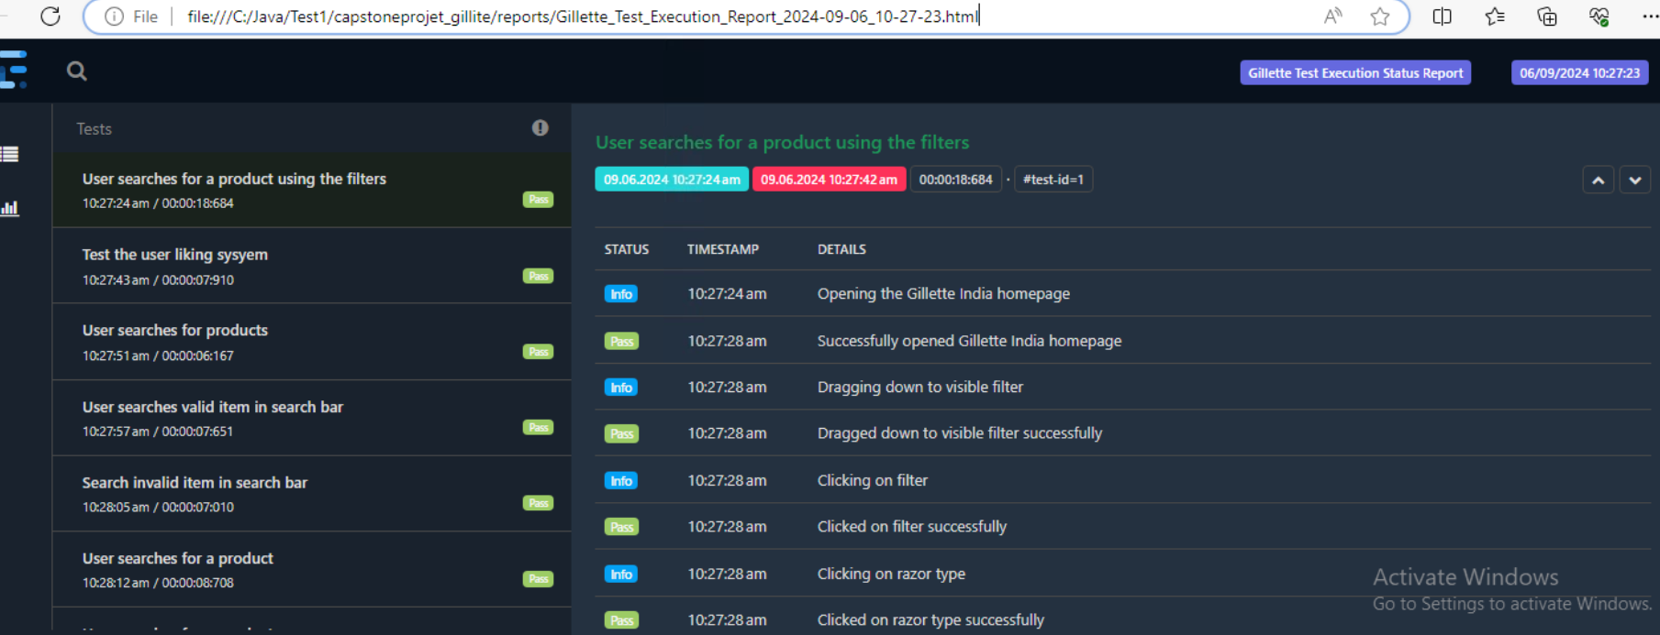
Selenium BDD with cucumber
Outcome:
2024 - RPS Consulting all rights reserved

Slide 8
API Testing
API Testing is a type of software testing that involves verifying the functionality, reliability, performance, and security of Application Programming Interfaces (APIs). APIs are sets of rules and protocols that allow different software applications to communicate with each other. Testing APIs ensures that they work as expected and meet their defined specifications.
Key Aspects of API Testing:
Tools used: Post Man , Rest Assured
Purpose: Validate API responses by using for learning and protype..
URL to be Automated: https://api.vschool.io/%5Byour_name%5D/todo
Methods to be automated: GET , POST , PUT , Delete.
…
2024 - RPS Consulting all rights reserved

Slide 9
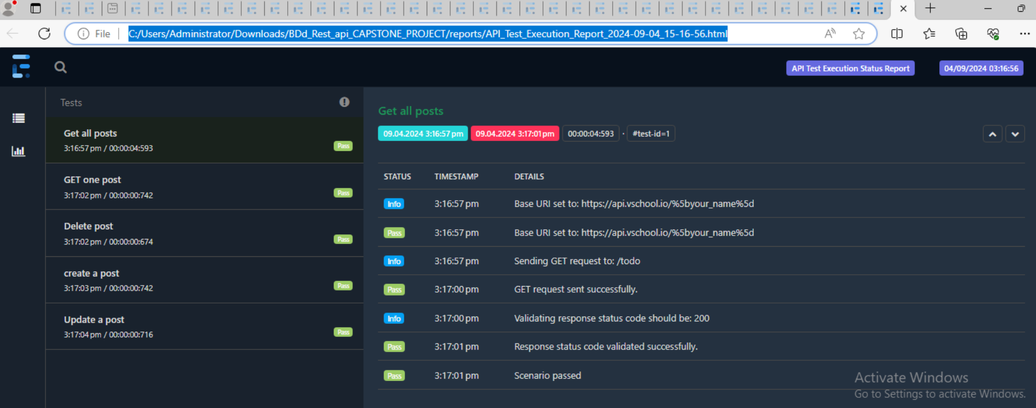
API Testing
Outcome:
2024 - RPS Consulting all rights reserved

Slide 10
Manual Testing
Manual Testing is a software testing process where testers execute test cases manually without using any automated tools or scripts. The goal is to identify defects, ensure that the software behaves as expected, and verify that it meets the specified requirements. Manual testing involves human testers interacting with the application as end-users would, to find issues and ensure the quality of the software.
Key Aspects of Manual Testing:
Test Planning : creating test plans ,defining test cases , setting up the test Environment.
Test Case design: Writing detailed test cases that outline the steps to be performed, the expected results, and any required test data.
Test execution: Performing operations such as inputting data, clicking buttons, navigating through the application, and verifying results.
Defect Reporting : documenting defects with detail such as steps to reproduce , screenshots and security levels.
2024 - RPS Consulting all rights reserved

Slide 11
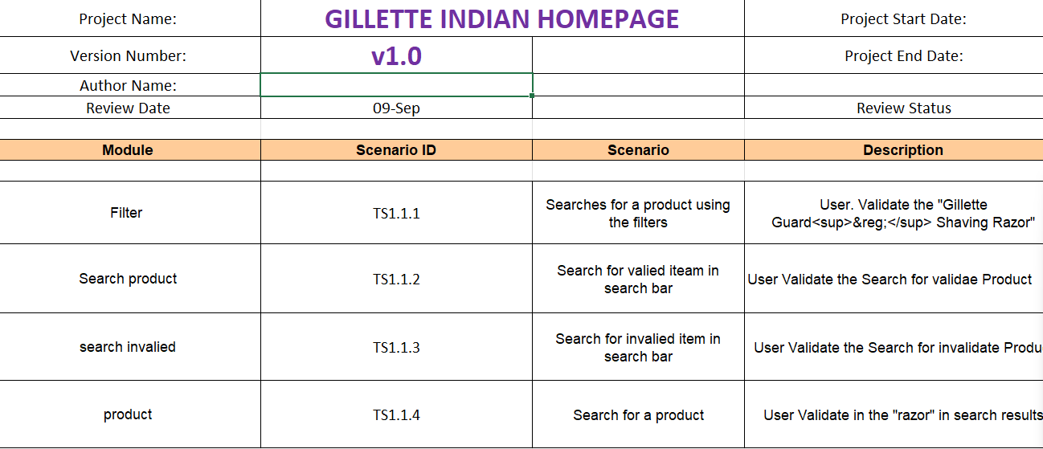
Manual Testing
Outcome1:
2024 - RPS Consulting all rights reserved

Slide 12
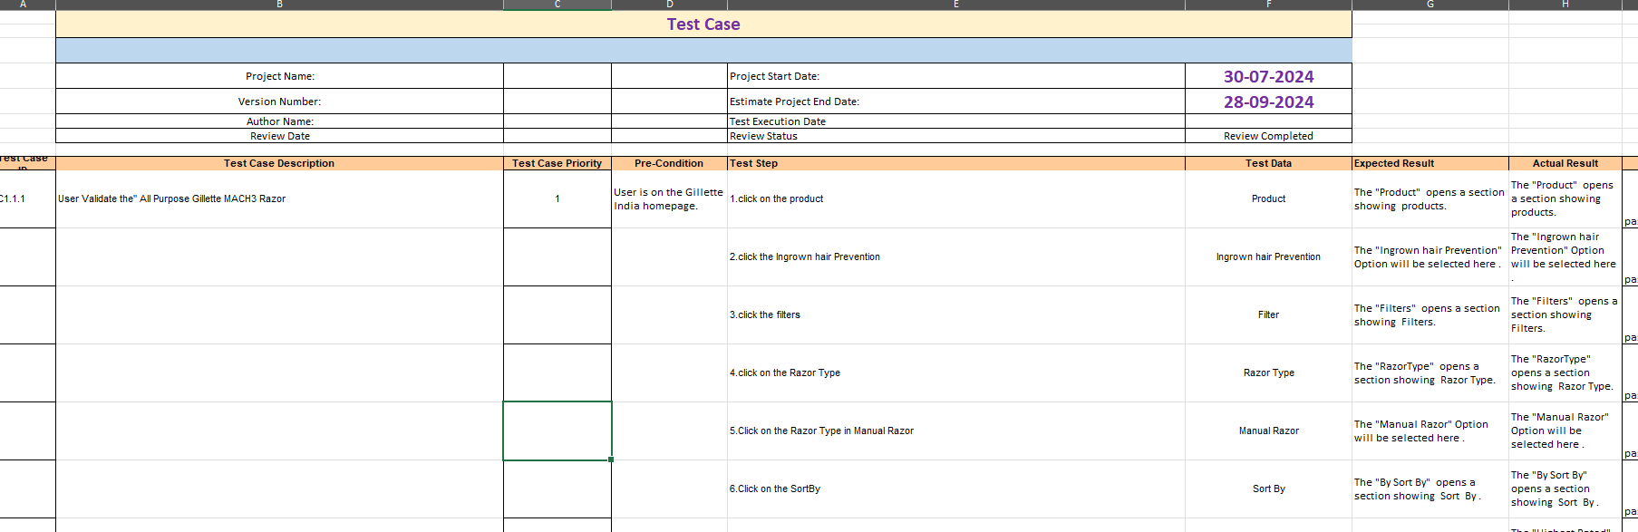
Manual Testing
Outcome2:
2024 - RPS Consulting all rights reserved

Slide 13

JIRA
It is a project Management tool , it is used by software development teams , it is an issue tracker , and it contains a group of tasks together
Key Features of JIRA:
Issue and Project Tracking:Supports various issue types such as bugs, tasks, stories, epics, and custom issue types, allowing teams to track different kinds of work.
Agile & Project Management : Provides Scrum boards for managing sprints, tracking progress, and visualizing tasks using boards, backlogs, and sprint planning.
Integration & Collaboration: Enables team members to comment on issues, mention other users, and collaborate directly within JIRA.
This Photo by Unknown Author is licensed under CC BY
2024 - RPS Consulting all rights reserved

Slide 14
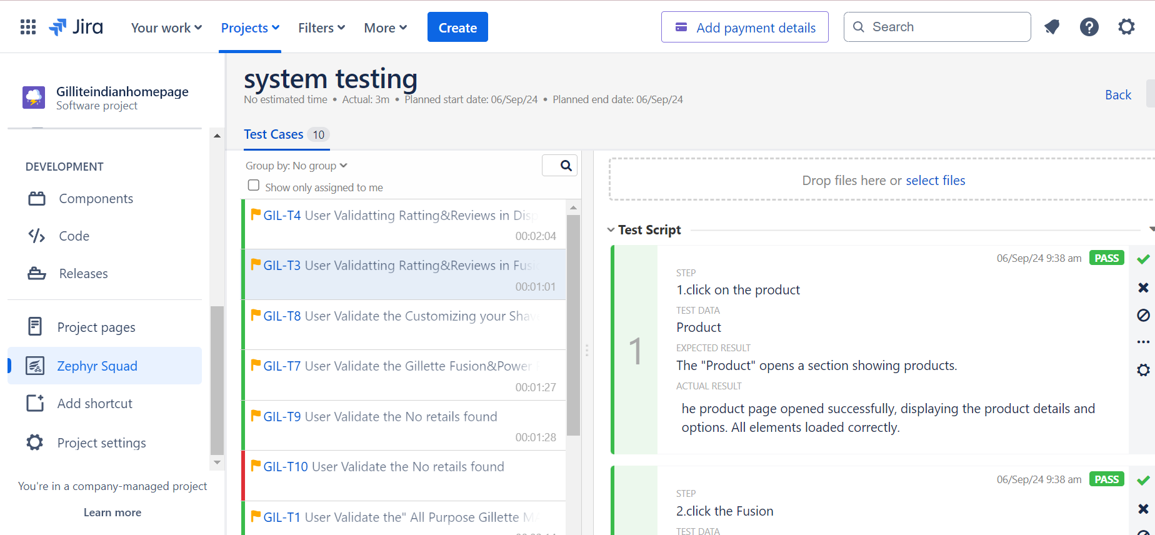
JIRA
Outcome1:Passed Test Case.
2024 - RPS Consulting all rights reserved

Slide 15
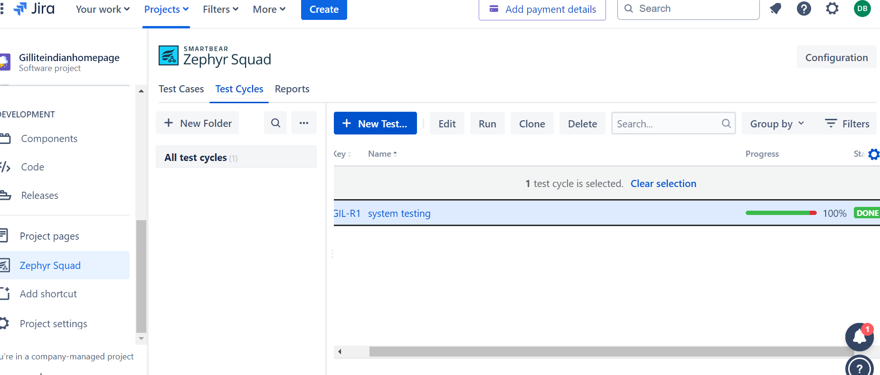
JIRA
2024 - RPS Consulting all rights reserved

Slide 16
Approach:
Testing Approach context:
Testing Strategy and Methodology and Combination of Manual and Automated Testing Integration of BDD with Selenium and API Testing Continuous Testing Practices.
2024 - RPS Consulting all rights reserved

Slide 17
Defects Found
Identified the bug in Jira , Identified User interface issues such as button alignment, broken links, and inconsistent styling . Found functional issues in checkout, cart synchronization, and API response delays . Defect Examples :Incorrect product filters returning invalid results . Cart synchronization issues between different devices . API returning incomplete or delayed responses for product search.
2024 - RPS Consulting all rights reserved

Slide 18
Major challenges Faced:
Complexity of the website(dynamic content)
Multi browser handling
Handling captchas
Test data management
2024 - RPS Consulting all rights reserved

Slide 19
CONCLUSION
The project successfully enhanced the quality assurance process for the Amazon.com website by implementing a robust automation strategy. The combination of manual testing, Selenium BDD with Cucumber, and API testing allowed us to thoroughly validate the website’s functionalities. Despite the challenges faced, we effectively addressed them and achieved our objectives, resulting in a more reliable and user-friendly application
Thank you for your attention. I am now open to any questions or further discussions.
2024 - RPS Consulting all rights reserved

